Slide 1

Business Data Warehousing

Slide 2

Telecommunications

Slide 3

AGENDA
Identifying design flaws in dimensional models
Providing recommendations for effective design reviews
Checklist for common design mistakes

Slide 4
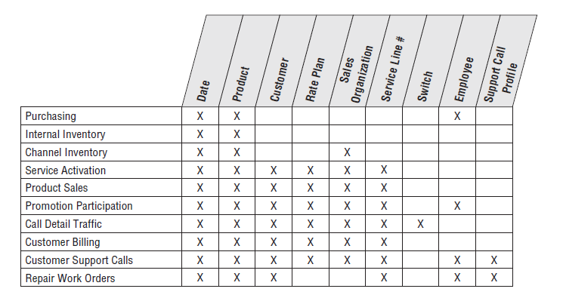
Bus Matrix snippet

Slide 5
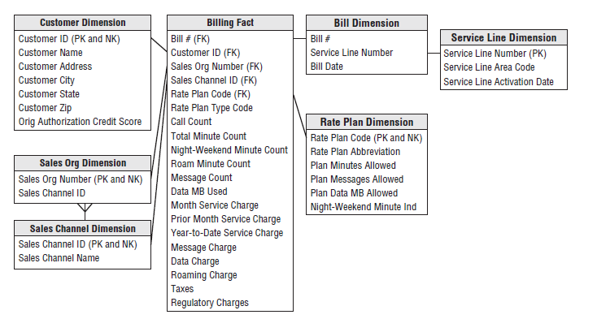
Draft Schema design

Slide 6
General Design review considerations
Balance Business Requirements and Source Realities
Focus on Business Processes
Granularity
Date Dimension
Surrogate Keys
Conformity Commitment

Slide 7
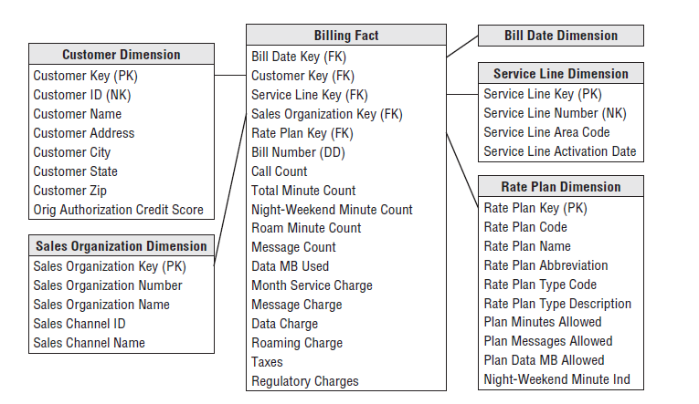
Revamped Draft Schema design

Slide 8

THANK YOU
Atul Inamdar
Vipul Suresh Sonje
Kousalya Sai Ramya Javvadi

